Slide 1
Rajshahi University of Engineering & Technology
Spectral-Spatial Classification of Hyperspectral Image Based on Stacked Autoencoder and Convolutional Neural Network
Student
Shafia Afrin
Roll:1503022
Dept. of CSE, RUET
Supervised By
Dr. Boshir Ahmed
Professor
Head of Dept. of CSE, RUET

Slide 2
Outline
Motivation
Objectives
Background Study
Literature Review
Dataset
Proposed Methodology
Experimental Results
Comparative Study
Future Work
References

Slide 3
Motivation
Linear feature extraction methods can’t deal with non-linear nature of Hyperspectral data
CNN has shown remarkable performance on other Computer Vision areas.
Individual high performance of Autoencoder & CNN has motivated us to combine them together
Widely used PCA-SVM method performs poorly on KSC dataset
Various experiments have shown Autoencoders are better at feature extraction than PCA [1]
1
2
3
4
5

Slide 4
Objectives
Using Stacked Autoencoder for feature extraction & dimensionality reduction
Using CNN to classify the extracted features by autoencoder
Compare the result with other benchmark methods
1
2
3

Slide 5
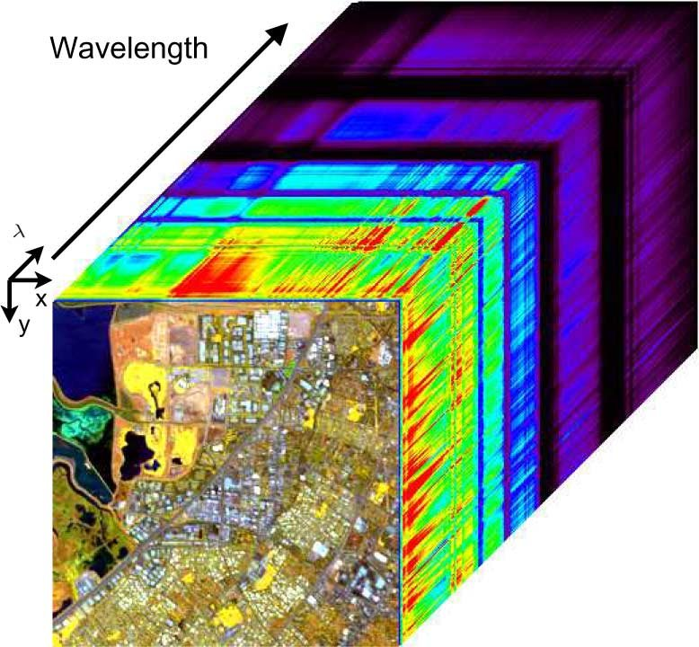

Background Study: Hyperspectral Image
Hyperspectral Image is the acquisition of hundreds of images at different set of wavelengths. Hyperspectral Image can be represented as :
$$HSI=(x,y,λ)$$
Where, x,y = spatial dimension
λ = number of spectral bands
That’s why Hyperspectral images are also known as Hypercube.
Fig 1. Hyperspectral data cube

Slide 6
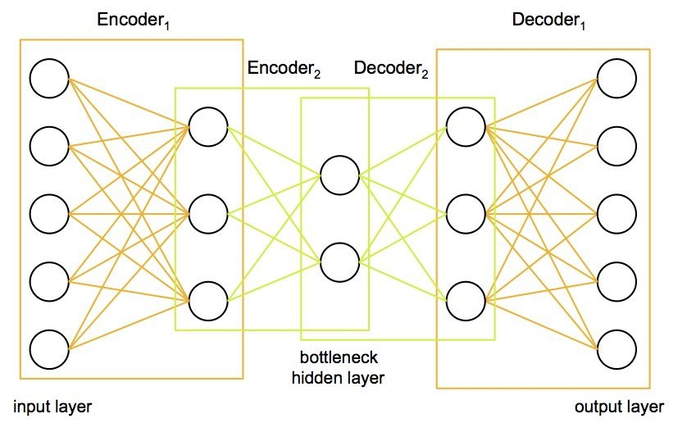
Background Study: Stacked Autoencoders
Unsupervised artificial neural networks.
Follows the working property of encoder-decoder.
Constructed by stacking multiple single layer autoencoders.
The hidden layer in one autoencoder becomes the input to the next one.
Fig. 2: Architecture of Stacked autoencoder .

Slide 7
Stacked Autoencoders (cont…)
A fully connected Stacked Autoencoder for reducing the HSI data has five parts -
Input: Number of spectral bands of HSI dataset
Hidden Layer (encoder) :2/3
Bottleneck layer nodes : desired reduced dimension
Hidden Layer (decoder) : Usually it’s a mirror image of encoder hidden layer
Output : The input is reconstructed. It has same number of spectral bands as input.

Slide 8
Stacked Autoencoders (cont…)
Input layer
Hidden Layer
(encoder)
Bottleneck
Hidden Layer
(decoder)
Output Layer
Fig 3. Simple Stacked Autoencoder Architecture for Dimensionality reduction

Slide 9
Background Study :2D CNN
There are three basic components of defining a basic convolutional network. They are:
The convolutional layer : Input image is convoluted using many types of filters for producing a feature map.
The Pooling layer : In this layer translation and scaling is done. This layer reduces the size of the feature map exponentially.
The Fully Connected layer : Same as the hidden layer in the neural network. In the fully connected layer all the inputs from one layer are connected to every unit of the next layer. It is usually connected to output layer.

Slide 10
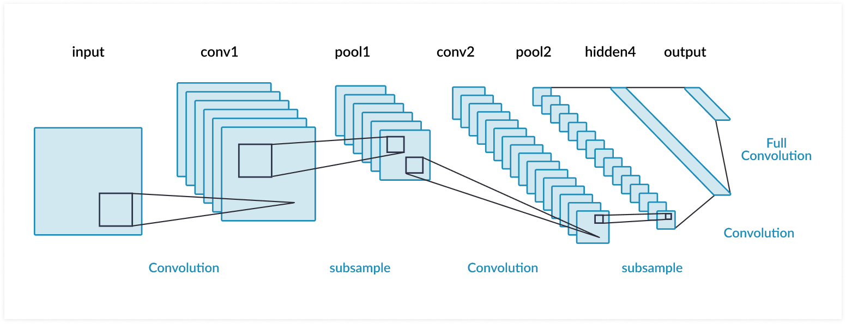
2D-CNN (cont…)
Fig. 4: General architecture of Convolutional Neural Network

Slide 11
Literature Review
Title | Author | Publication Info. | Contribution | Limitation & Scope
Spectral-Spatial Classification of Hyperspectral Image Using Autoencoders [2] | Zhouhan Lin, Yushi Chen, Xing Zhao, Gang Wang | ICSPIC 2013 | For the very first time Stacked Autoencoder was used for dimension reduction in HSI. | Used autoencoder only with SVM classifier.

Slide 12
Literature Review
Title | Author | Publication Info. | Contribution | Limitation & Scope
Hyperspectral Image Classification With Deep Learning Models [3] | Xiaofei Yang, Yunming Ye, Xutao Li; Raymond Y. K. Lau | ITGRS 2018 | Several CNN model was previewed for Hyperspectral Image classification | Feature extraction methods were not mentioned

Slide 13
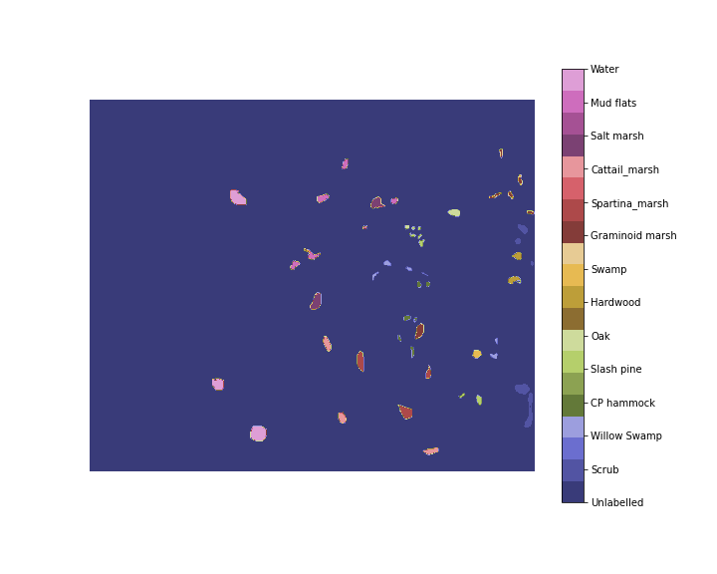
Dataset
We have chosen Kennedy Space Center dataset for our experiments.
The NASA AVIRIS instrument acquired data over the Kennedy Space Center (KSC), Florida, on March 23, 1996.
Spatial size is 512x614
It has 176 spectral bands
It has 13 classes
Number of labeled pixel is 5211
.
Fig. 5: Ground Truth of Kennedy Space Center Dataset

Slide 14
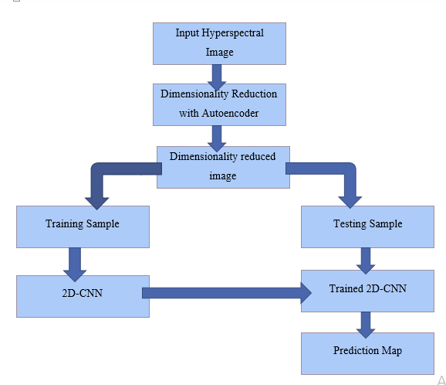
Proposed Methodology
Fig. 6: An overview of Stacked Autoencoder-CNN approach

Slide 15
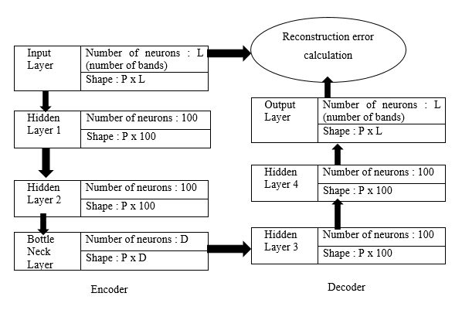
Proposed Methodology : Autoencoder
On the input layer number of neuron is equal to the number of bands.
The hidden layers has 100 neurons
The bottleneck layer has preferably 25 neurons
L1 regularizer was used in each encoder layer to avoid Overfitting.
So the subsequent layers were of size :
176-100-100-25-100-100-176
Fig. 7: Proposed architecture of Stacked Autoencoder

Slide 16
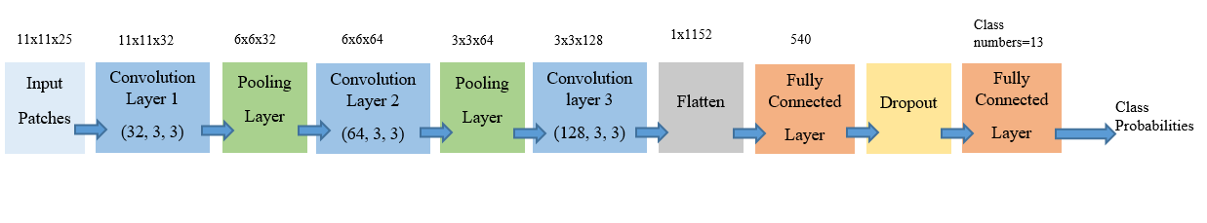
Proposed Methodology : 2D-CNN
Fig. 8: Proposed architecture of 2D-CNN
Input was divided in 11x11 size patches
Convolution filters are of size 3x3
Firstly convoluted using 32 filters
Secondly convoluted using 64 filters
Thirdly convoluted using 128 filters

Slide 17
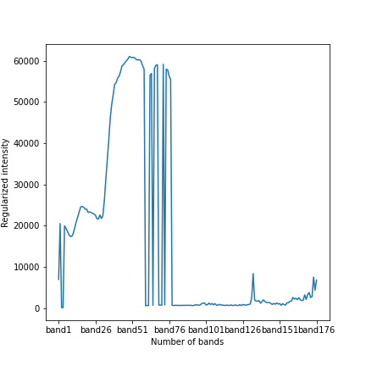
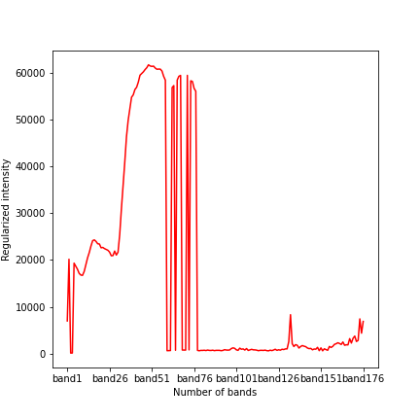
Result Analysis
Stacked Autoencoder :
(a)
(b)
Fig. 9: Reconstructions of KSC data in different reduced dimension (a) Input data (b) reconstructed data from 25 dimensions

Slide 18
Result Analysis
Dimensions | Window 3x3 | Window 5x5 | Window 7x7 | Window 11x11
7 | 88.11% | 97% | 97% | 99%
15 | 94% | 97% | 99% | 99.5%
20 | 91.67% | 98% | 99% | 99.8%
25 | 94% | 97% | 99% | 99.9%
Table 3: Performance of SAE-2DCNN model on different dimension and patch size

Slide 19
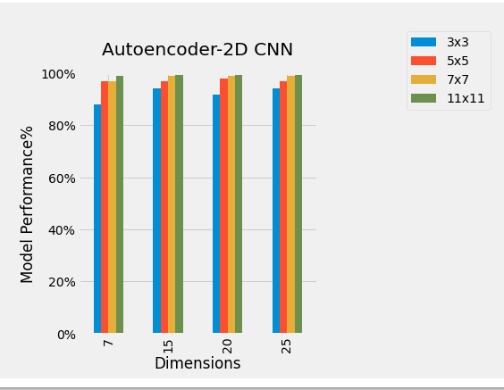
Result Analysis
Decision:
Classification accuracy arises with the increase of dimensions and patch size.
Fig. 10: Performance Chart of SAE-2DCNN model on different dimension and patch size

Slide 20
Result Analysis
Class name | Number of Train samples | Number of Test samples | AE-2D CNN accuracy For dimension = 25, Patch size = 11x11
Scrub | 609 | 152 | 100%
Willow Swamp | 194 | 49 | 100%
CP hammock | 205 | 51 | 97.5%
Slash Pine | 202 | 50 | 96%
Oak / broadleaf | 129 | 32 | 84%
Hardwood | 183 | 46 | 96%
Swamp | 84 | 21 | 100%
Graminoid marsh | 345 | 86 | 100%
Spartina Marsh | 416 | 104 | 100%
Cattail Marsh | 323 | 81 | 100%
Salt Marsh | 335 | 84 | 100%
Mud Flats | 402 | 101 | 100%
Water | 741 | 186 | 100%
Average Accuracy |  |  | 99%
Overall Accuracy |  |  | 98%
Kappa Accuracy |  |  | 99%
Table 4. Classification accuracy of combined approach SAE-2DCNN on Kennedy Space Centre dataset

Slide 21
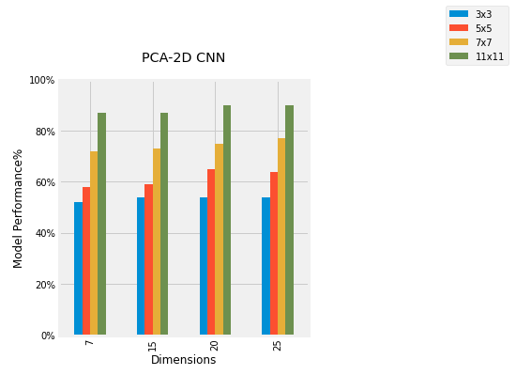
Comparative Study :
Dimensions | 3x3 | 5x5 | 7x7 | 11x11
7 | 52% | 58% | 72% | 87%
15 | 54% | 59% | 73% | 87%
20 | 54% | 65% | 75% | 90%
25 | 54% | 64% | 77% | 90%
Table. 5: Performance PCA with 2D-CNN classifier
Fig. 11: Performance PCA with 2D-CNN classifier

Slide 22
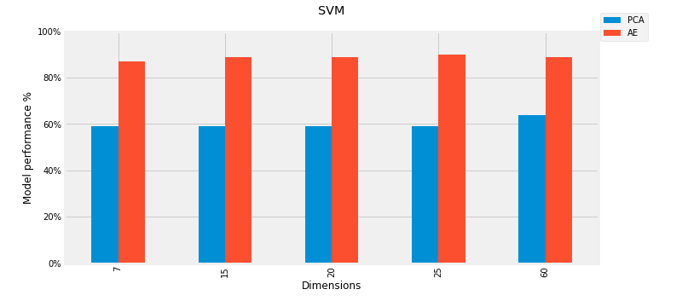
Comparative Study :
Dimensions | PCA-SVM | AE-SVM
7 | 59% | 87.15%
15 | 59% | 89%
20 | 59% | 89%
25 | 59% | 90%
60 | 64% | 89%
Table. 6: Performance PCA and SAE with SVM classifier
Fig. 12: Performance PCA and SAE with SVM classifier

Slide 23
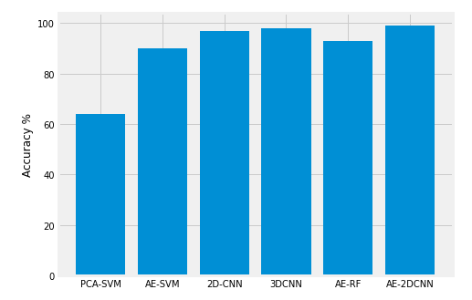
Comparative Study :
Decisions:
SAE-2DCNN combination performs significantly better than any other combination.
Autoencoder extracts better feature than PCA on KSC dataset. Autoencoder can improve the perform the performance of SVM classifier.
Despite PCA being a bad dimension reduction technique for KSC dataset with combination of 2D-CNN it performs good.
Deeper representations are always leading to better classification accuracies.
Fig. 13: Comparison between proposed hybrid methods along with other benchmark methods

Slide 24
Limitations
The complexity of both the deep learning models are very high.
Combining two deep learning models leading it to too many parameters that are needed to be trained.
Both the models take very high time to be trained. Which is a constraint for commercial use.

Slide 25
Future Work
In future we can apply this hybrid classification model to other datasets and see how it performs on different datasets.
We can apply our model to other classification tasks and see how it performs. There are various other deep learning models.
In future we can work for reducing the runtime
We can try to combine the Stacked Autoencoder and CNN in one model.

Slide 26
References
A. Cheriyadat and L. M. Bruce, "Why principal component analysis is not an appropriate feature extraction method for hyperspectral data," IGARSS 2003. 2003 IEEE International Geoscience and Remote Sensing Symposium. Proceedings (IEEE Cat. No.03CH37477), Toulouse, France, 2003, pp. 3420-3422 vol.6, doi: 10.1109/IGARSS.2003.1294808.
Zhouhan Lin, Yushi Chen, Xing Zhao and Gang Wang, "Spectral-spatial classification of hyperspectral image using autoencoders," 2013 9th International Conference on Information, Communications & Signal Processing, Tainan, 2013, pp. 1-5, doi: 10.1109/ICICS.2013.6782778.
X. Yang, Y. Ye, X. Li, R. Y. K. Lau, X. Zhang and X. Huang, "Hyperspectral Image Classification With Deep Learning Models," in IEEE Transactions on Geoscience and Remote Sensing, vol. 56, no. 9, pp. 5408-5423, Sept. 2018, doi: 10.1109/TGRS.2018.2815613.

Slide 27
Thank You

